Slide 1

Analysis of Shuttlers NG Geospatial Data

Slide 2
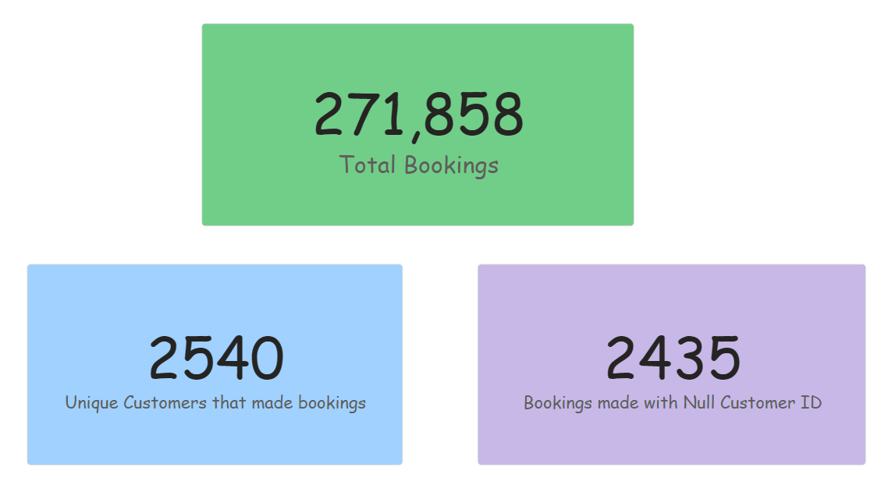

Slide 3
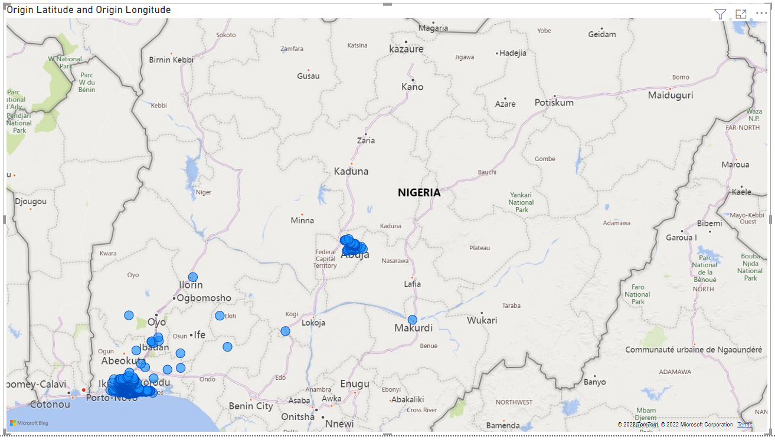
Booking coordinates showed that more than 80% of bookings were made in the South-West of Nigeria, Lagos state precisely, followed by Abuja and a few other locations

Slide 4
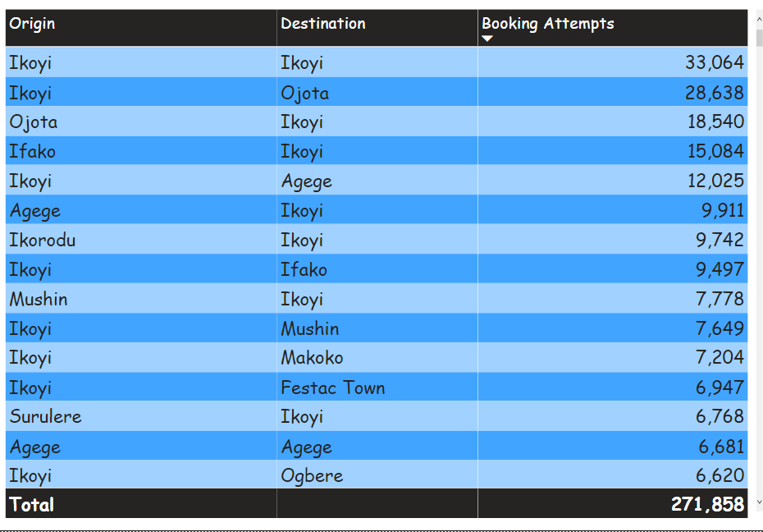
The table below shows the top 15 routes with the total booking attempts on them

Slide 5
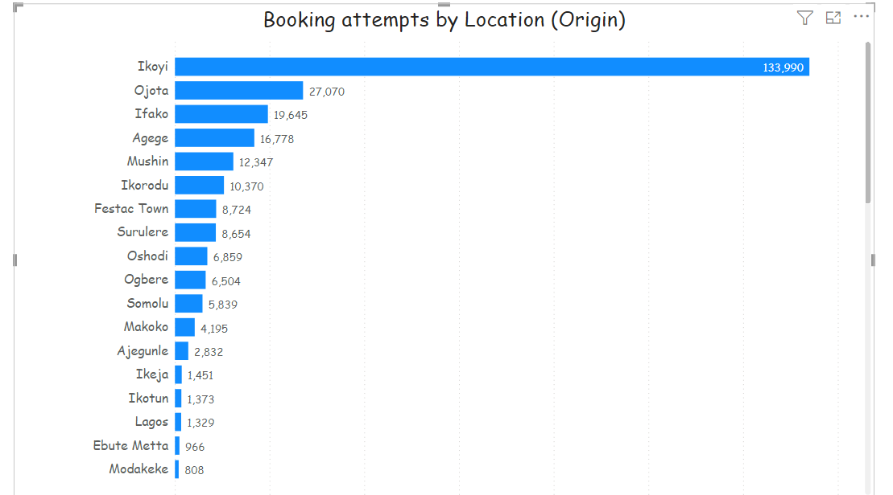
﻿Booking attempts was highest for Ikoyi at 133,990, followed by Ojota and Ifako.
﻿Ikoyi accounted for 49.29% of bookings.
﻿Across all 50 Origin Location, bookings ranged from 1 to 133,990.

Slide 6
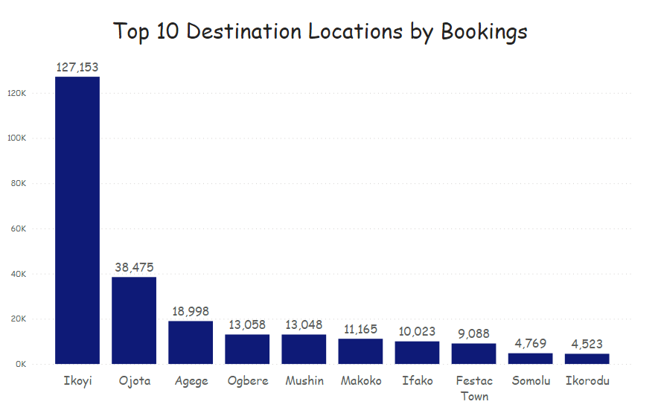
﻿At 127,153, Ikoyi had the highest destination booking and was 2,711.25% higher than Ikorodu, which had the lowest destination booking at 4,523.
Ikoyi accounted for 50.80% of destination bookings.
﻿Across all 10 Destination Location, destination booking ranged from 4,523 to 127,153.

Slide 7
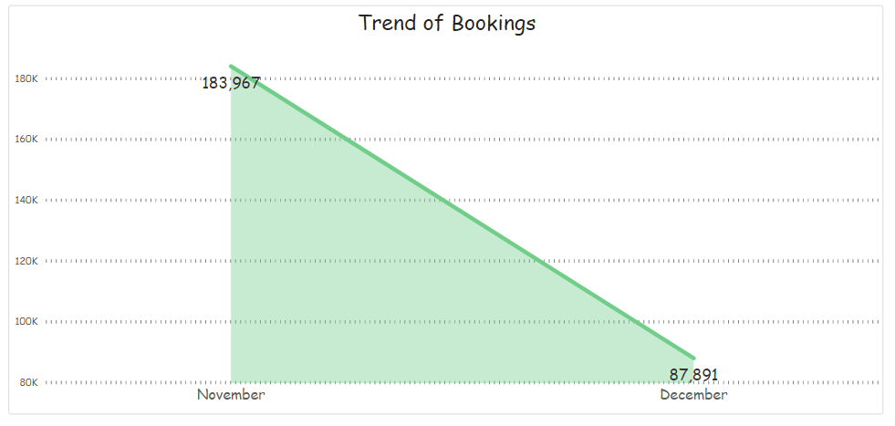
﻿Customer bookings trended down, resulting in a 52.22% decrease between November 2021 and December 2021.

Slide 8
Recommendations
Important fields such as date and customer ID should be correctly captured at the time of registration and booking to prevent null values that can skew results of analysis.
Based on what was shared, more data should be gotten on customer demographics for analytics purpose, marketing and even product design.
Pricing data is required for comparative analysis with industry average.

